Slide 1
Cloud Computing Project
Hotel Recommendation
Kai Chen(kc3443)
Haonan Wu(hw1651)

Slide 2
Overview
When people go outside, sometimes it is hard for tourists to find a satisfiable hotel to live in the nearby neighborhood. Therefore, we plan to build a hotel recommendation web service to help recommend hotels for the tourists.
Our recommendation web service will record users’ operation and find out proper hotel based on the preference of users’.

Slide 3
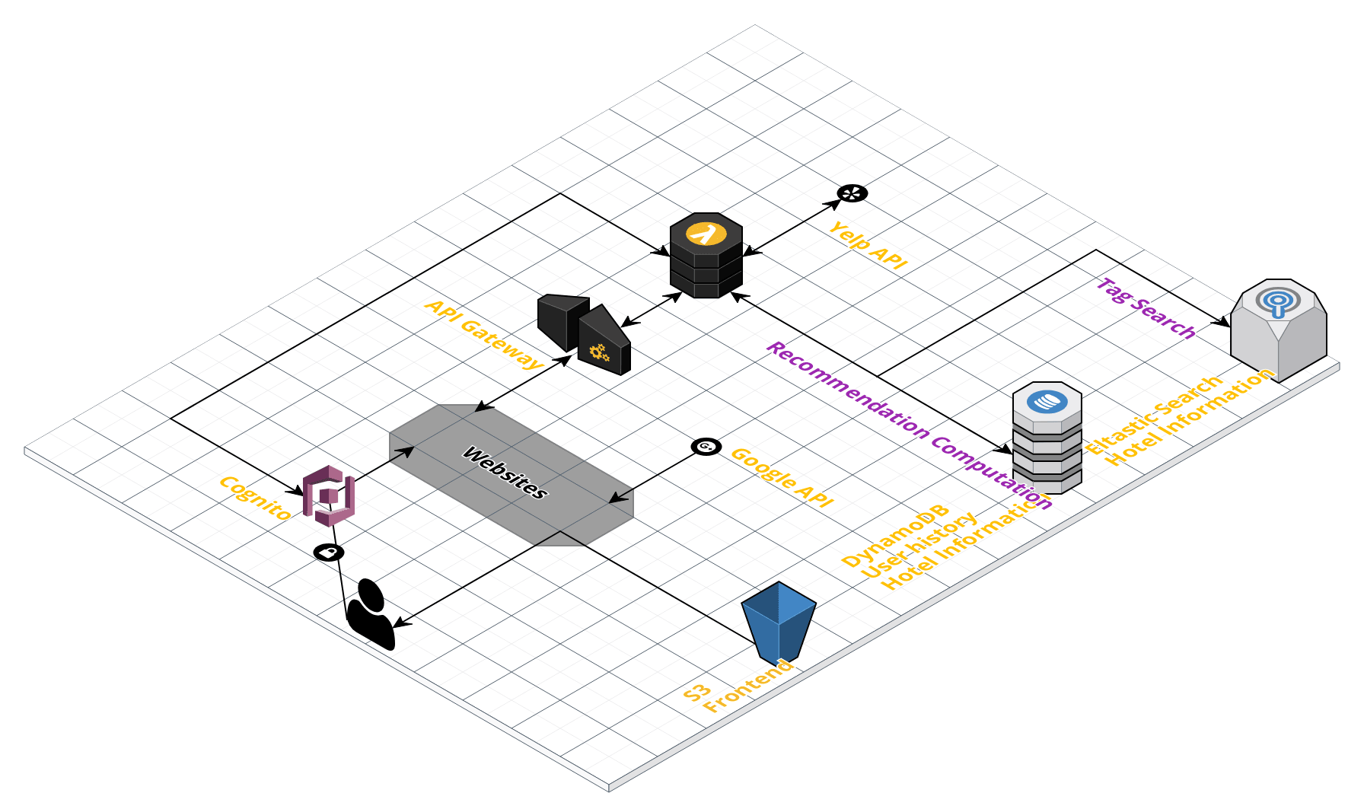
Architecture
Front end is build in React JS, and store in S3.
The login service is supported by AWS Coginto.
The API Gate is used to connect the front end with the lambda function.
Lambda functions will get the hotel data from DynamoDB and process the recommendation algorithms.
Lambda functions will get the hotel data from ElasticSearch to provide tag searching service.
Lambda functions will record the users’ operation in front end and store them into DynamoDB

Slide 4
Recommendation Algorithms
Get hotel information from Yelp API and store them into DynamoDB.
Cold start: use some simple strategies to recommend initial hotels
Personal recommendation: for each hotel, we will do
Use the record of the user-selected features, we count the Jaccard Similarity with current hotel. If it is too low (<= 0.1), we will not recommend it.
Use the record distance age (Di = aDi-1 + (1-a)Di-2), we count the max_distance = (Jaccard Similarity + 1) * Di, and if the distance of current hotel is large than max_distance, we will not recommend it.
Then sort the hotel by Jaccard Similarity, and return to the frontend.

Slide 5
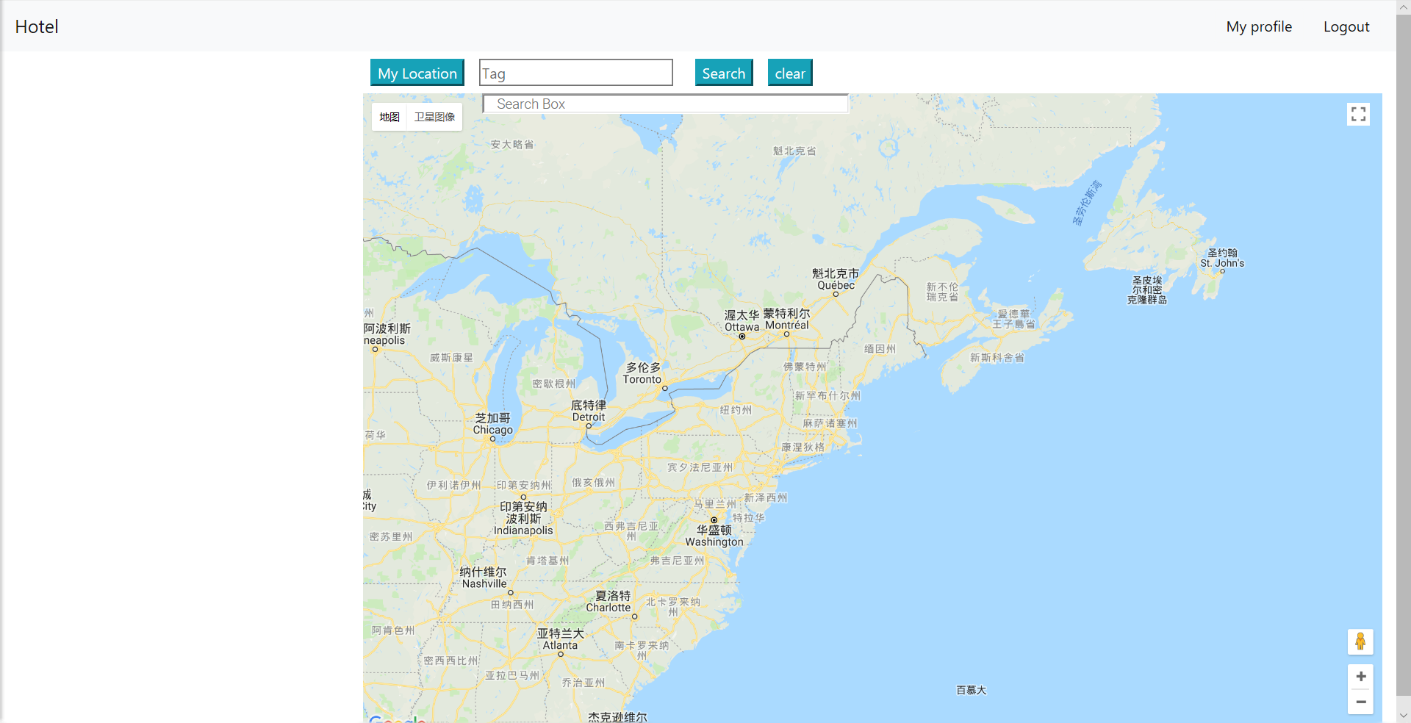
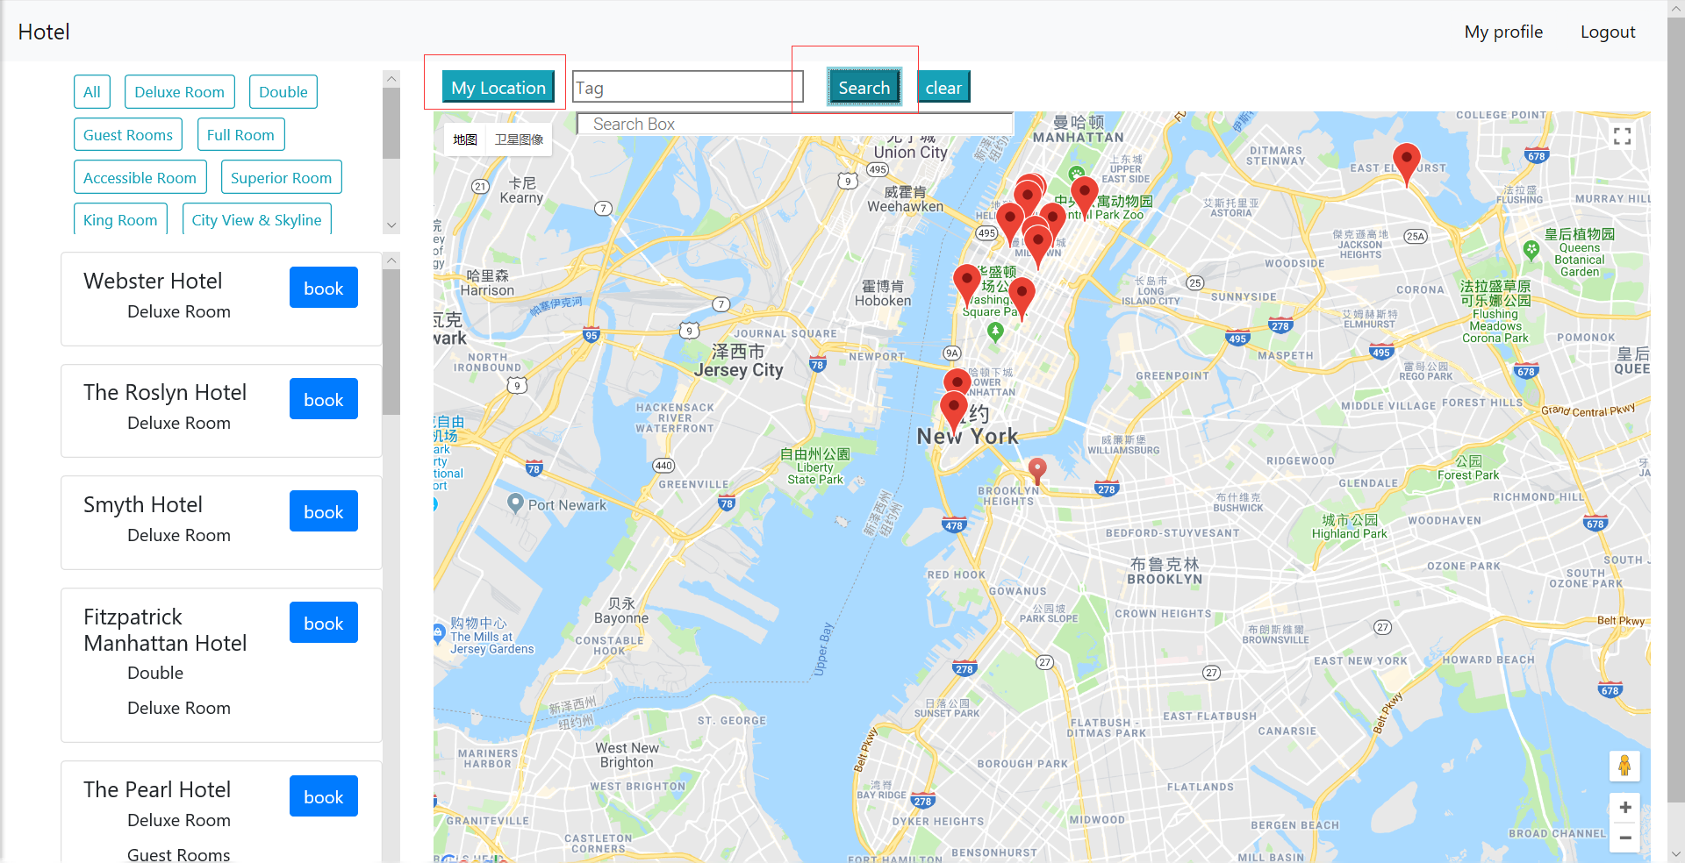
Result

Slide 6
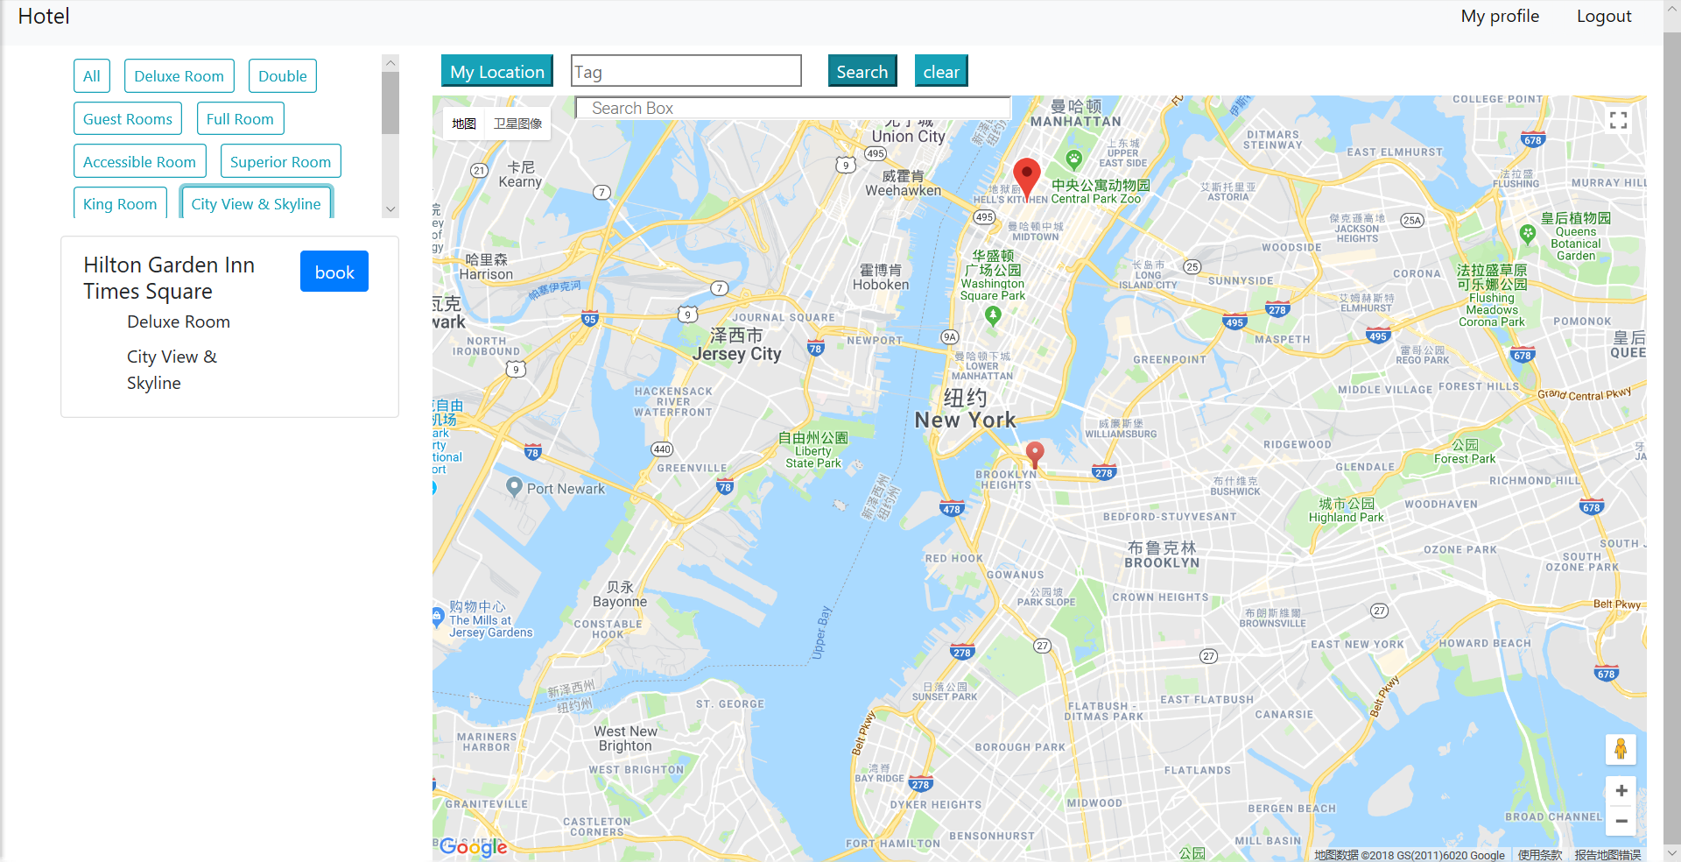
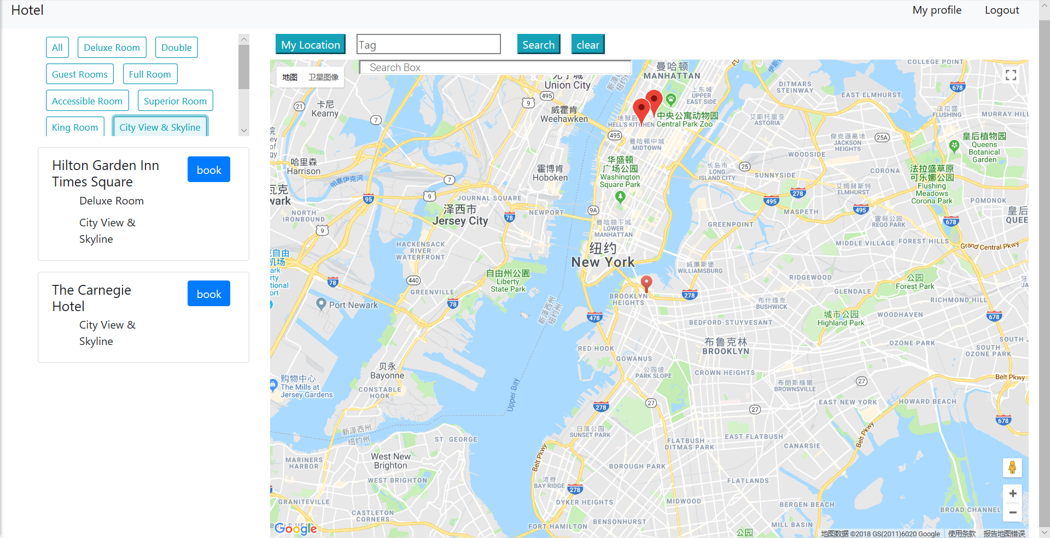
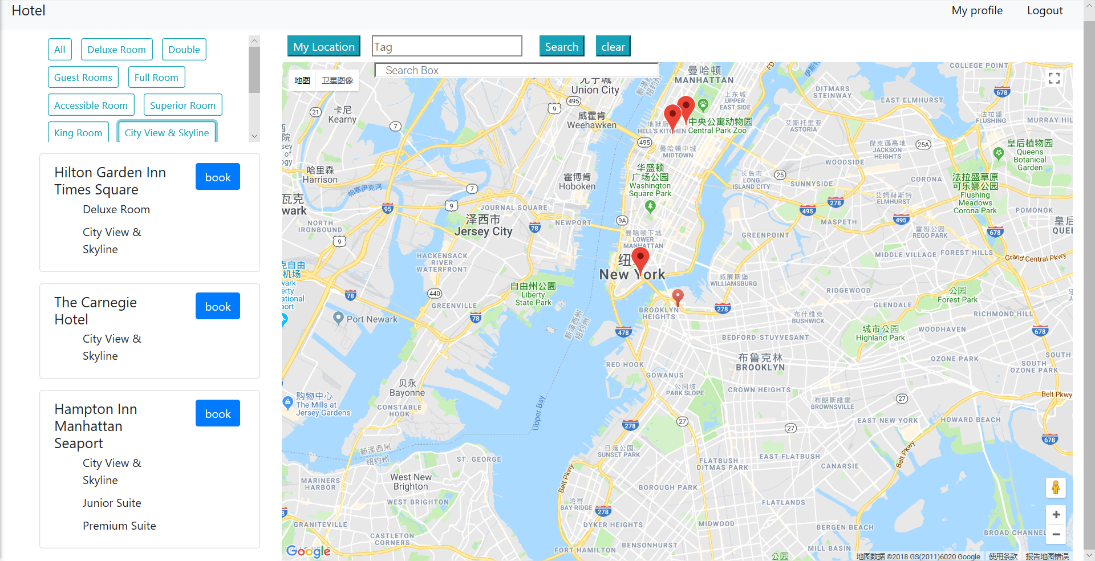
Result

